Slide 1
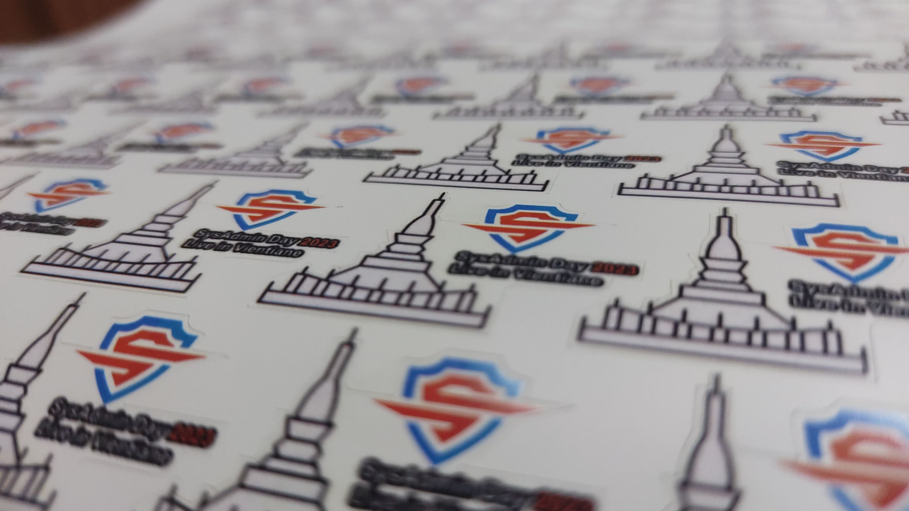

Slide 2


Slide 3


Slide 4

Image by macrovector on Freepik

Slide 5
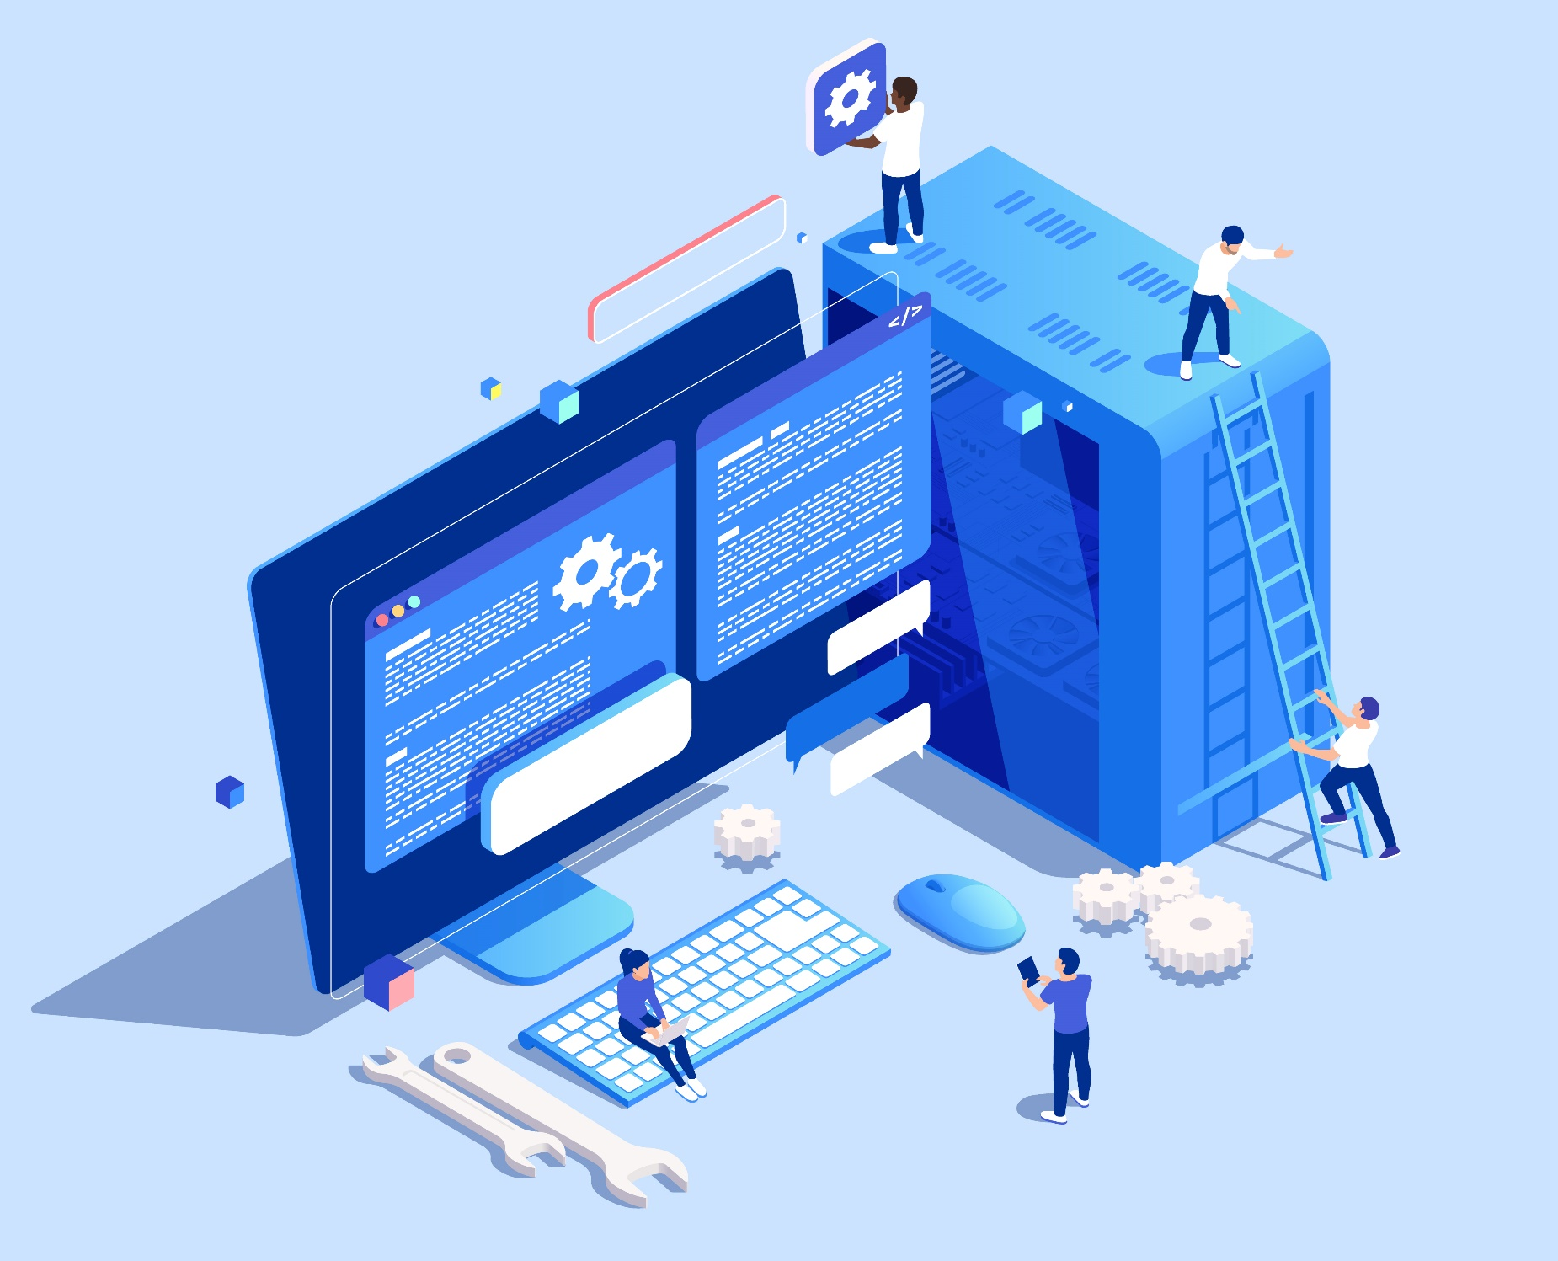
h
Sys
Admin
Image by macrovector on Freepik

Slide 6
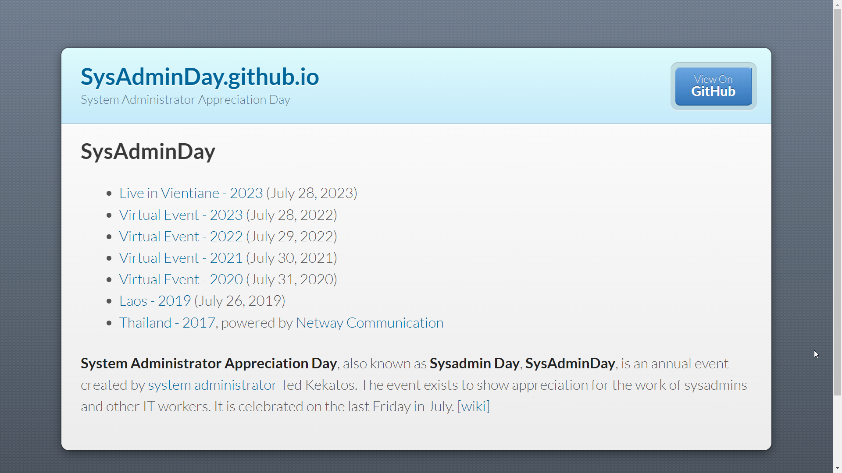
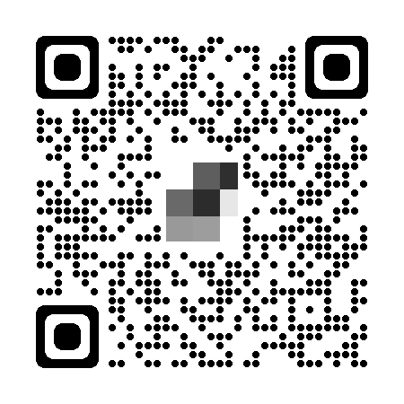
https://SysAdminDay.github.io

Slide 7
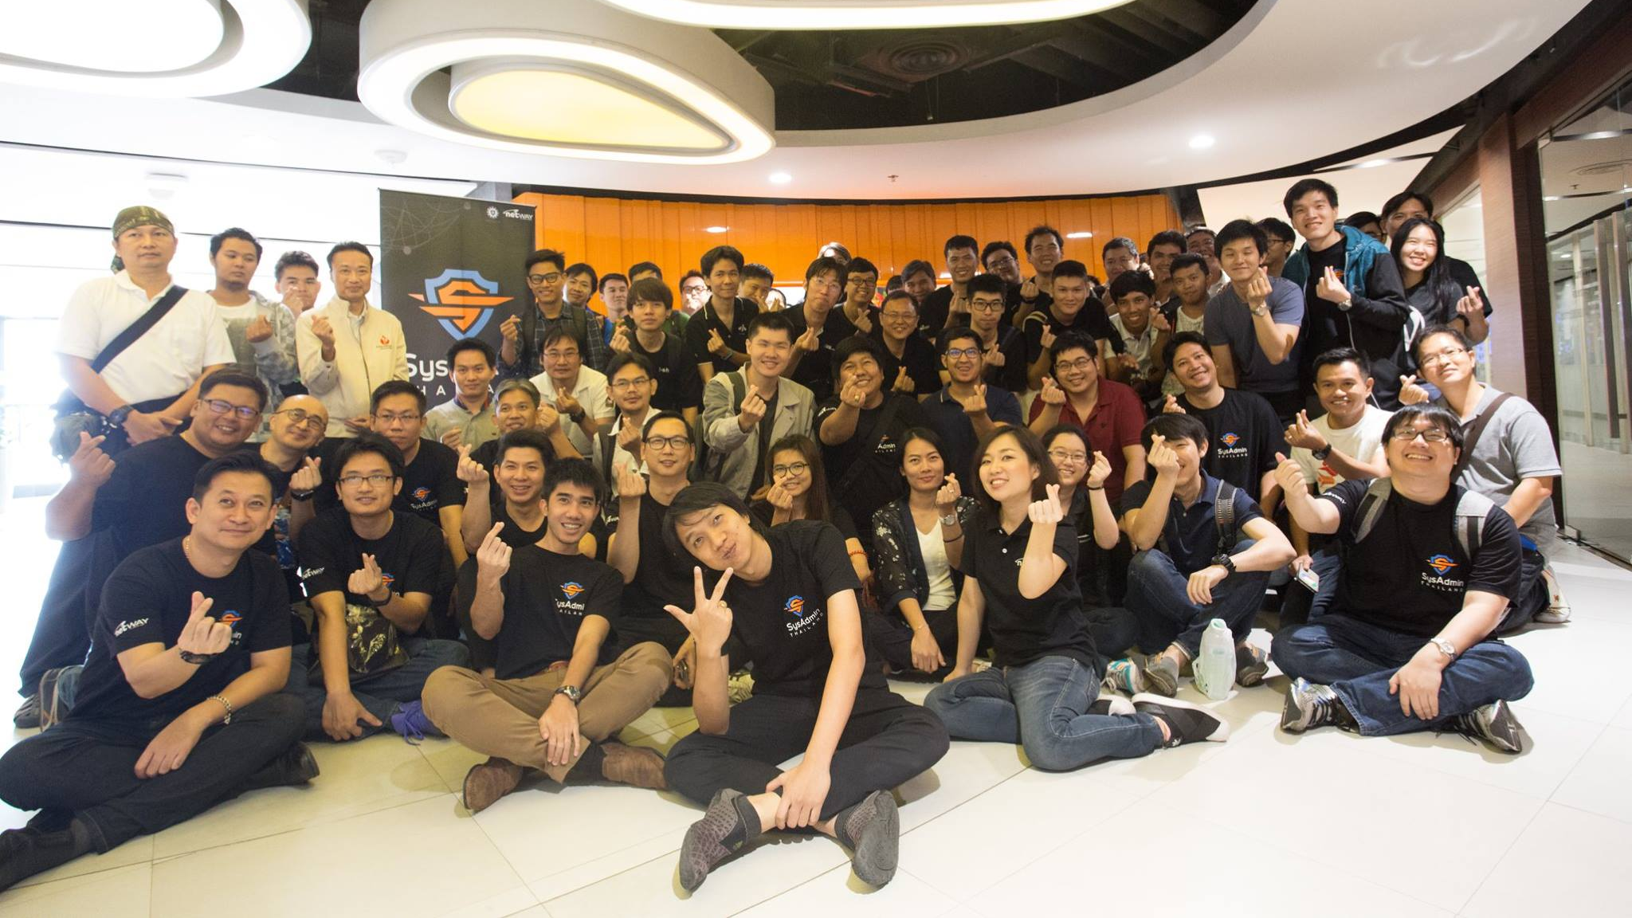

Slide 8
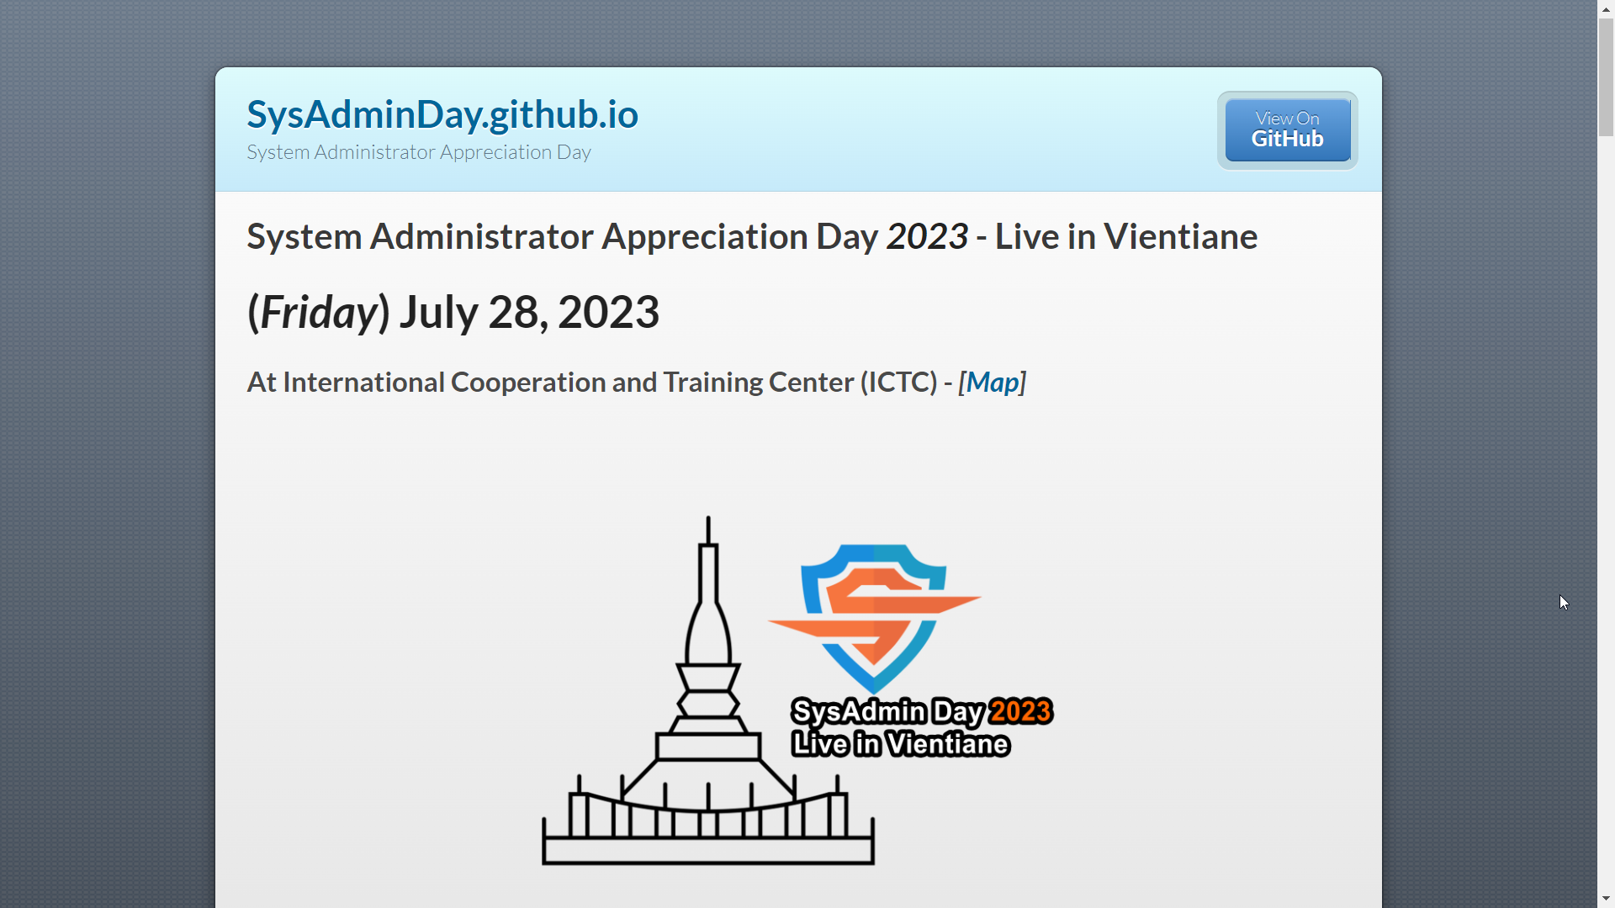
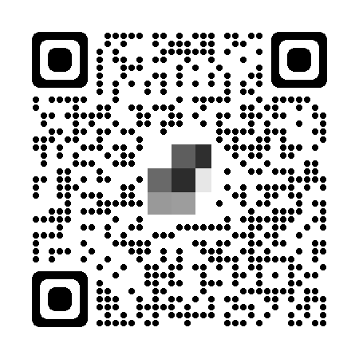
https://SysAdminDay.github.io/2023/VTE

Slide 9
